Slide 1



Hardware and Software Fundamentals of Intelligent Computing Systems

Slide 2
Lecture 20: Intermediate Representation (IR) Fundamentals

Slide 3
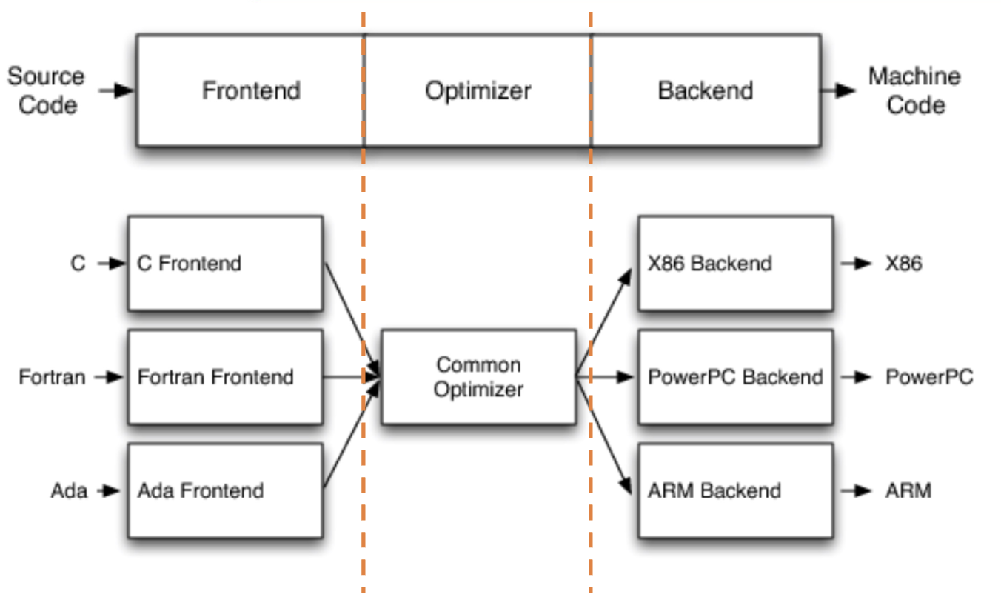
Deep Learning Compilation Framework
Frontend
Lexical and Syntactic Analysis, AST Construction, Semantic Checking, IR Transformation
Middle-End//Optimizer
Performing various IR -level optimizations
Backend
Instruction Selection, Register Allocation, Code Generation
LLVM, Chris Lattner, http://aosabook.org/en/llvm.html

Slide 4
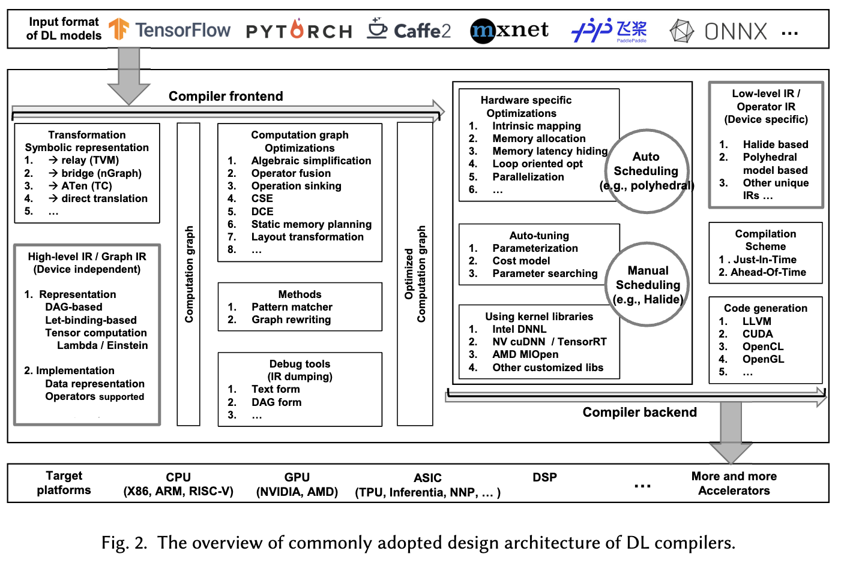
IR Design Goals
Decoupling Hardware Constraints:
In modern software development, there is a huge semantic gap between frontend languages and underlying hardware.
IR 's core role is to completely decouple high-level framework intent from low-level silicon instructions.
Resolving the Catastrophic M x N Problem:
Suppose there are M deep learning frontend frameworks and N different hardware accelerators.
Without a unified IR, the industry would need to develop M x N independent compilers.
After introducing a standard IR , only M frontend translators and N backend code generators, reducing engineering complexity to M + N.
Li, Mingzhen, et al. "The deep learning compiler: A comprehensive survey." IEEE Transactions on Parallel and Distributed Systems 32.3 (2020): 708-727.

Slide 5
IR Design Goals
Preserving High-Level Semantics, Rejecting Premature Lowering
Value of Semantic Information:
In traditional general-purpose compilers (e.g., GCC/LLVM), an operation is typically lowered to scalar loops and pointer arithmetic. But in deep learning IR , a 2D convolution must be preserved as an atomic conv2d(input, weight) nodes .
Foundation for Global Optimization:
If neural network operations are prematurely lowered to for loops, the compiler loses the“this is a convolution” macro-level understanding, preventing invocation of convolution-specific hardware acceleration libraries.
Macro-Level Graph Optimization:
Leveraging this high-level semantic-preserving IR data structure, the compiler can perform computation graph-level algebraic simplification, operator fusion, and memory planning from a global perspective .

Slide 6
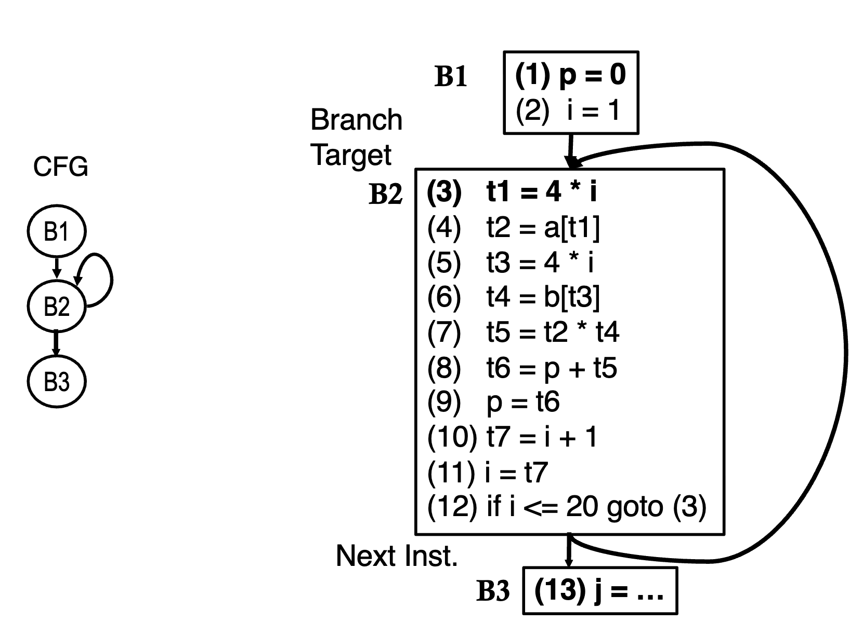
Execution Model — Control Flow Graph (CFG)
Program Counter-Based (PC) Traditional Logic
Node Definition: as Basic Blocks (Basic Blocks): Graph nodes are segments of“branch-free” continuous straight-line instruction sequences. Once entered, instructions execute from beginning to end.
Graph Edgesas Control Flow Directions: Directed edges in the graph represent the temporal execution sequence logic and jump targets (corresponding to if/else, while, for and other control statements in high-level languages).
Execution Driving Mechanism: Highly dependent on the von· Neumann architecture's core program counter (PC）.
https://www.csl.cornell.edu/~zhiruz/5997/pdf/lecture04.pdf

Slide 7
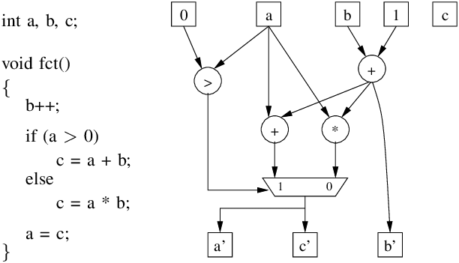
Execution Model — Data Flow Graph (DFG)
Data-Driven Computation Discarding Temporal Ordering
Node Definition: Mathematical Operations: Graph nodes are no longer basic blocks but represent specific mathematical operations or primitives.
Graph Edgesas Data Lifecycles: Directed edges represent the pure mathematical dependencies and flow paths of data (i.e., multi-dimensional tensors in deep learning) between operation nodes.
Execution Driving Mechanism: Completely discarding code-line sequential constraints. The sole condition for triggering a computation node is: all its required upstream input data is ready.
https://www.researchgate.net/figure/Data-flow-graph-example_fig2_224517165

Slide 8
CFG v.s. DFG
Characteristic | Control Flow Graph (CFG) | Data Flow Graph (DFG)
Core Modeling Object | Program execution order and logical branch paths. | Data value transfer paths and mathematical operation dependencies.
Graph Nodes (Nodes) Represent | Basic blocks (contiguous instruction sequences without branches). | Mathematical operators (e.g., matrix multiplication, convolution).
Graph Edges (Edges) Represent | Control flow directions, loop jumps, conditional branch targets. | Data definition (output) flowing to data usage (input).
Execution Trigger Condition | Program counter (PC) sequentially pointing to the node. | All required upstream input data has been computed and is ready.
Parallelization Potential | Very low. Constrained by strict instruction execution order and hard-to-predict branches. | Very high. Naturally exposes maximum parallelism at both operator and instruction levels.
Typical Application Scenarios | General software, OS kernels, business logic control. | Deep learning tensor computation graphs, digital signal processing.
Generated by Gemini 3.1 Pro.

Slide 9
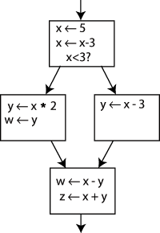
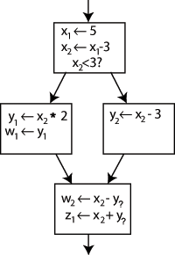
Static Single Assignment (SSA) Form
The Nightmare of Traditional Code:
Variables can be repeatedly overwritten (e.g., x = 1; x = x + 1), making it difficult for the compiler to track “which line generated the current x ” .
SSA Requirement:
in SSA form, the IR , every variable in the program can be assigned exactly once throughout its entire lifetime .
Version Splitting Mechanism: If a variable is assigned multiple times in the original code, the compiler automatically generates multiple new versions with incrementing subscripts (e.g., $x_1, x_2, x_3$）.
Functional Transparency: in SSA , “a variable name” is equivalent to“the unique instruction that produced it”, making the code mathematically unambiguous .
https://en.wikipedia.org/wiki/Static_single-assignment_form

Slide 10
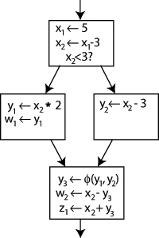
Φ (Phi) Function
Logical Conflict:
When execution flow passes through if/else branches and reconverges at a basic block, which version of the variable should subsequent code use? (e.g., if if produces x_1, else produces x_2）.
Φ Function (Phi-node):
To maintain the SSA single-assignment rule, the compiler inserts a virtual instruction at the join point, e.g., x_3 = Φ(x_1, x_2) .
Runtime Dynamic Routing:
Φ function acts as a multiplexer. During actual program execution, it selects the correct source variable based on which control flow edge was taken (x_1 or x_2), and assigns the value to a brand new variable x_3.
https://en.wikipedia.org/wiki/Static_single-assignment_form

Slide 11
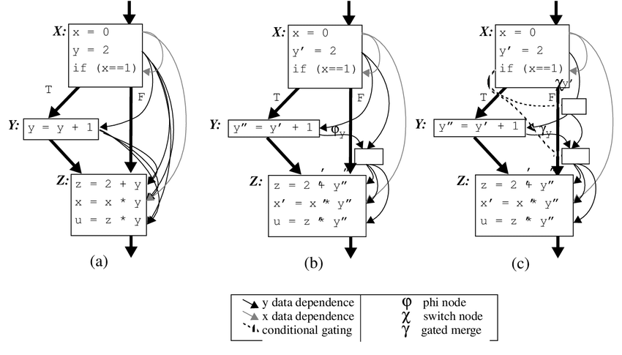

Def-Use chains
Traditional Non- SSA Combinatorial Explosion:
Since state can be overwritten, finding all possible sources of a variable requires complex bit-vector dataflow analysis, with time and space complexity reaching macroscopic O(N^2).
State Transfer Equations:
SSA O(N) Complexity:
For any variable usage (Use), its uniquely corresponding source definition (Definition) in the code is absolutely determined.
Every variable definition point can clearly hold a list directly pointing to all its use points in the global graph
https://www.researchgate.net/figure/Comparison-of-data-flow-representations-a-def-use-chains-b-SSA-and-c-Gated_fig4_2729044

Slide 12
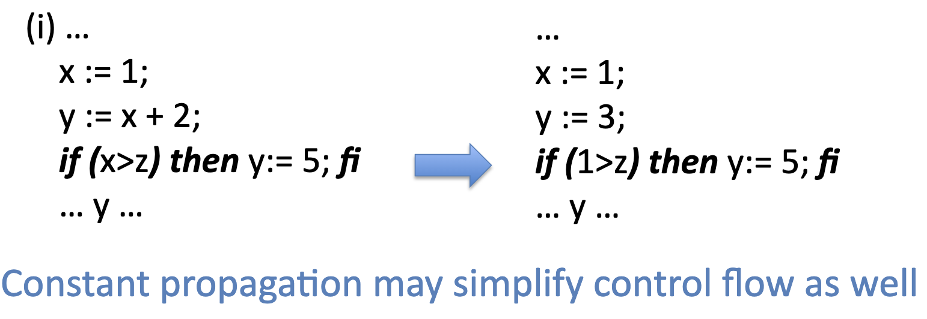
SSA inConstant Folding and Propagation
Concept: Pre-computing at compile time expressions that would otherwise be computed at runtime.
SSA 's: When the compiler encounters y = x + 2 , it can be directly folded to 3. Because SSA guarantees that x 's value will never be accidentally altered downstream.
Constant Propagation (Constant Propagation): Following the SSA -provided O(N) complexity DU chain, the compiler can propagate this constant 3 to all places in the global graph using y and replace them, significantly reducing computation and potentially simplifyingcontrol flow.
https://www.cs.utexas.edu/~pingali/CS380C/2013/lectures/ssa-slides.pdf

Slide 13
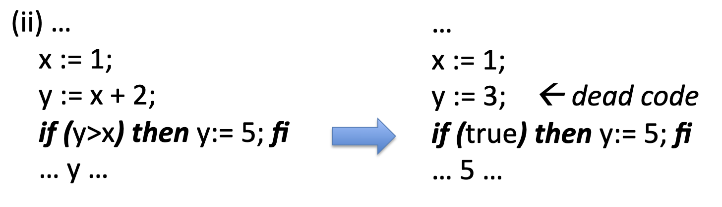
SSA inDead Code Elimination
Concept: Removing redundant instructions whose computation results never substantively impact the final program output.
in SSA , identifying dead code becomes a simple operation:: If an SSA variable's Use-chain list is empty, it is eliminable dead code.
Cascading Elimination Effect: After removing the node, its upstream input variables' use-chains also become empty, causing dead code marking to propagate backward through the graph instantly, triggering cascading elimination. This is crucial for cleaning up the massive redundant nodes generated by automatic differentiation (Autograd) .
https://www.cs.utexas.edu/~pingali/CS380C/2013/lectures/ssa-slides.pdf

Slide 14
Computation Graph Optimization Techniques
Core Objective:
Improving hardware execution efficiency, reducing GPU memory usage, and minimizing kernel (Kernel) launch overhead while preserving model mathematical equivalence .
Optimization Level Hierarchy:
Node-level Optimization (Node-level): Examining individual computation nodes in isolation .
Block-level Optimization (Block-level): Analyzing adjacent node sequences or computation blocks .
Dataflow//Graph-level Optimization (Dataflow/Graph-level): Macro-level optimization surveying the global topology .

Slide 15
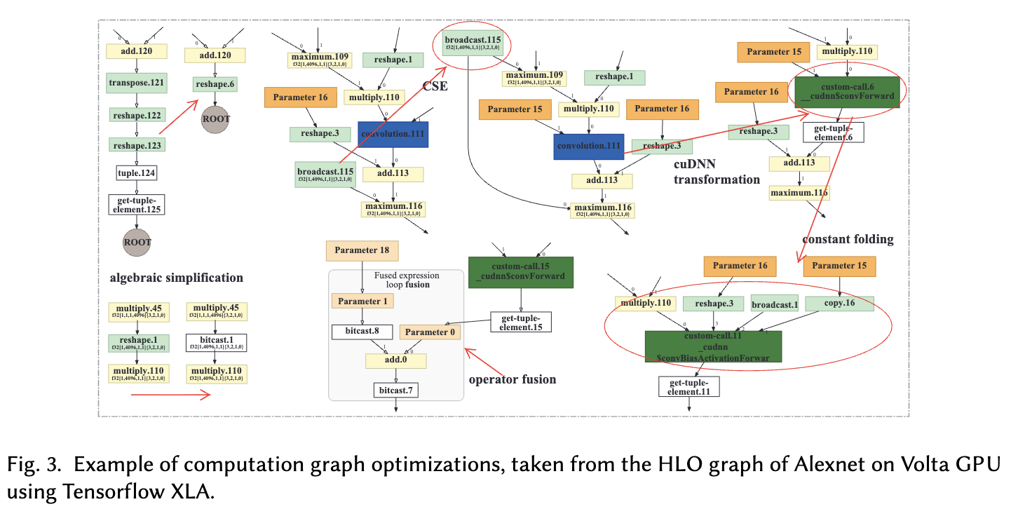
Computation Graph Optimization Techniques

Slide 16
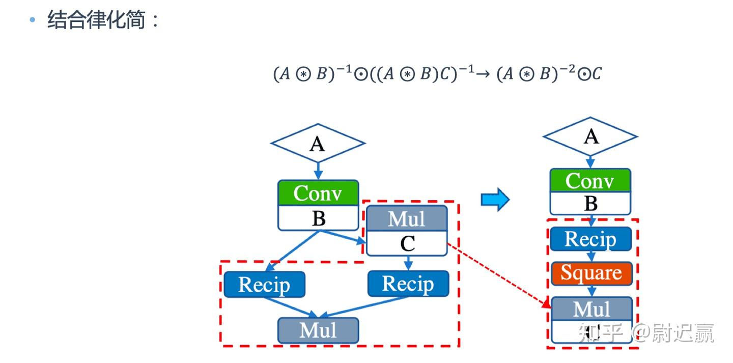
Computation Graph Optimization Techniques
Node-level Optimization Nop Elimination (Nop Elimination): Removing redundant nodes that have no substantive impact on results.
Zero-dim-tensor Elimination (Zero-dim-tensor Elimination): Safely removing computations on tensors with shape 0 (e.g., shape=(0, 5, 3))'s computation.
Block-level Optimization:Algebraic Simplification
Concept: Using mathematical rules such as commutativity, associativity, and distributivity to replace complex local node sequences with computationally cheaper equivalent forms .
Constant Folding (Constant Folding): Identifying all constant expressions known at compile time, pre-computing the results, and folding them into a single constant value in the graph .
https://zhuanlan.zhihu.com/p/661774755

Slide 17
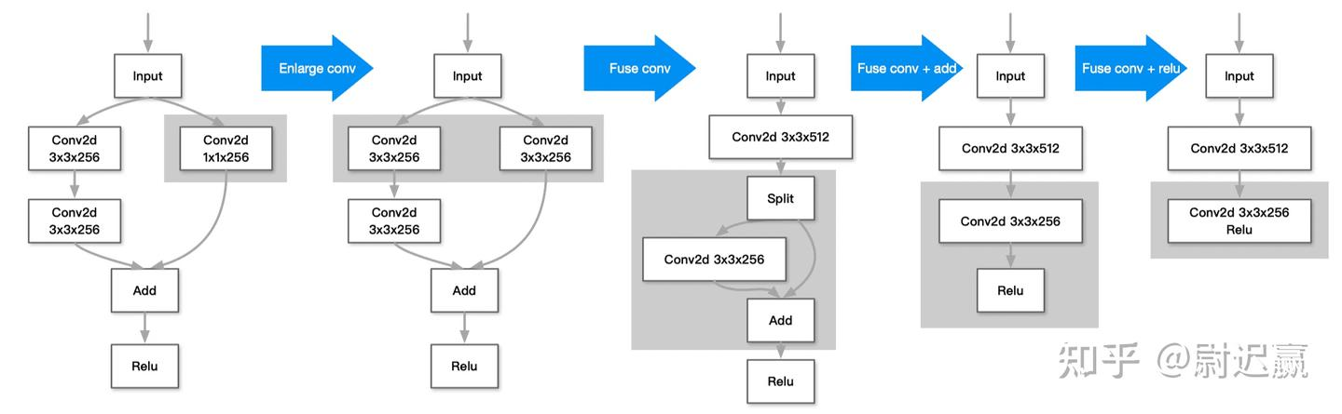
Computation Graph Optimization Techniques
Block-level Optimization:Operator Fusion
Problem: Each small operator needs to read/write data from global memory, causing memory bandwidth bottleneck and GPU Kernel launch latency.
Vertical Fusion:
Merging sequentially dependent operations into a single Kernel, with data flowing directly through registers, reducing global memory accesses.
Horizontal Fusion:
Merging adjacent operators that can be processed in parallel into a single Kernel, improving the utilization of underlying hardware compute units.
https://zhuanlan.zhihu.com/p/661774755

Slide 18
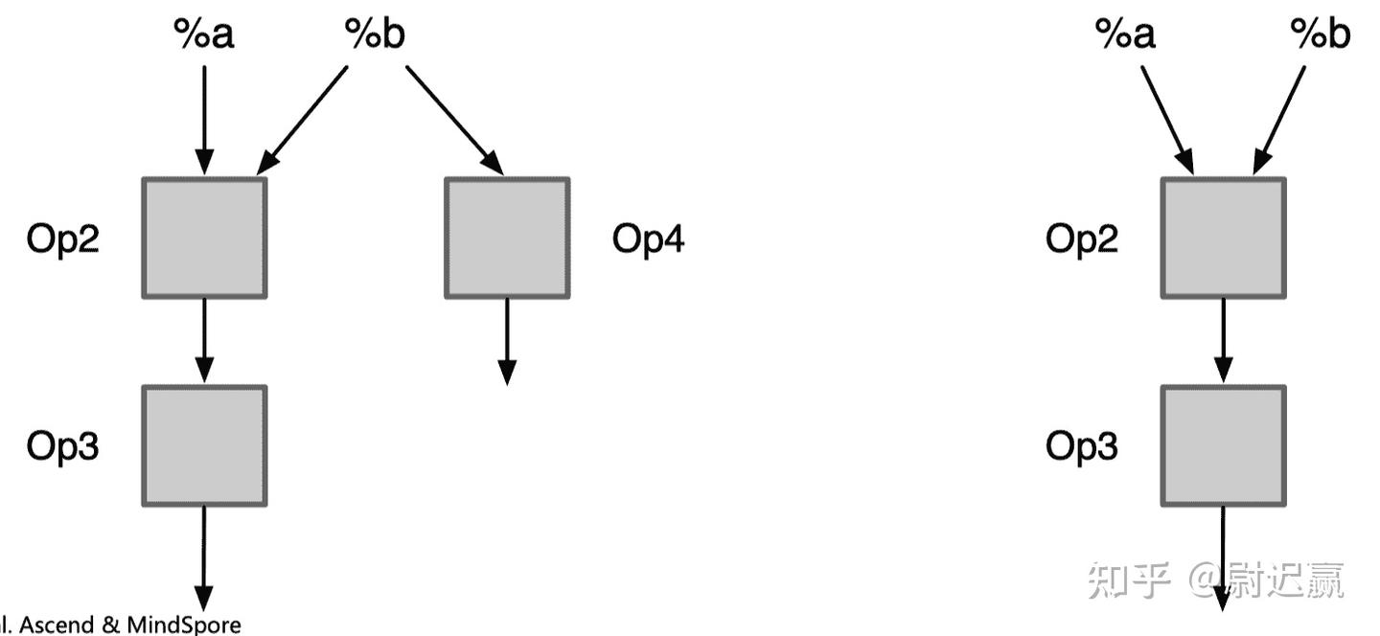
Computation Graph Optimization Techniques
Graph-level Optimization:Dataflow Structure Reshaping
Common Subexpression Elimination (Common Subexpression Elimination, CSE): Identifying identical substructures repeatedly computed in the graph, replacing them with references to a single common output to avoid wasting computational resources.
Dead Code Elimination (Dead Code Elimination, DCE): Combining Def-Use chain analysis, from the graph deleting useless operation branches .
Operator Sinking (Operator Sinking): Deferring certain dimension transformation operations (e.g., Transpose) along the graph's dataflow direction to merge potential subsequent redundant transformation operations.
https://zhuanlan.zhihu.com/p/661774755

Slide 19
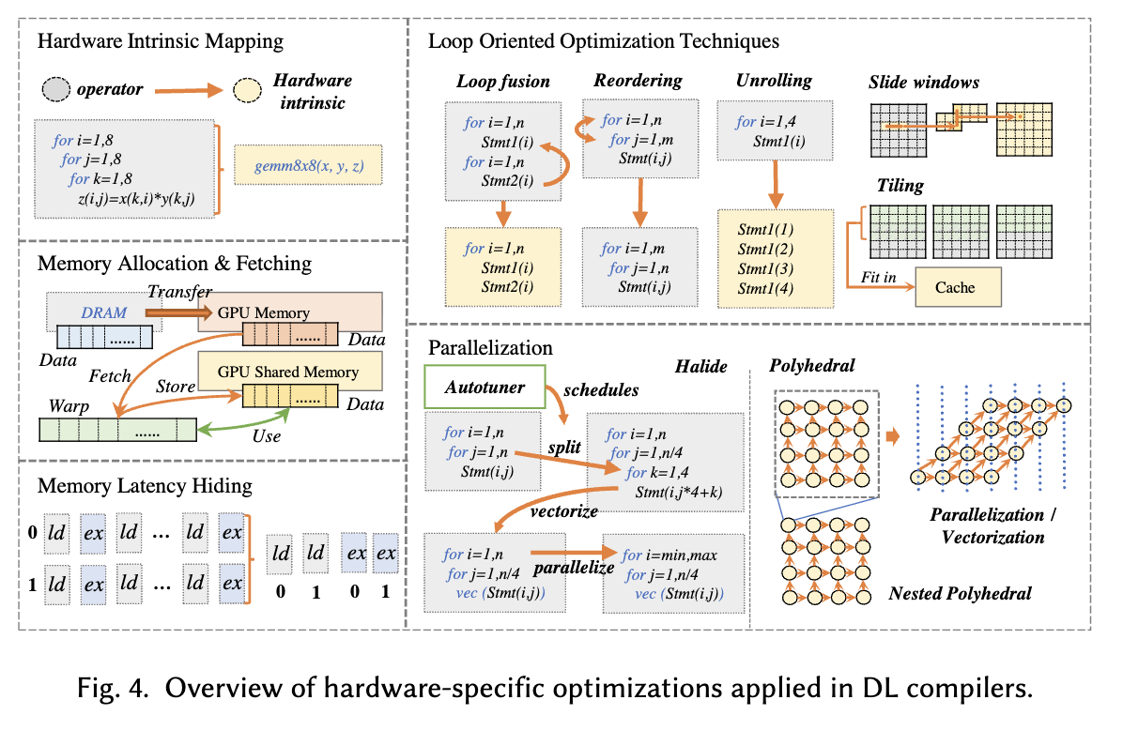
Hardware-RelatedOptimization
Li, Mingzhen, et al. "The deep learning compiler: A comprehensive survey." IEEE Transactions on Parallel and Distributed Systems 32.3 (2020): 708-727.

Slide 20

The Solution: FlagOS, a Unified AI Software Stack

Slide 21








https://space.bilibili.com/3546791834290849
https://github.com/flagos-ai
https://www.zhihu.com/people/95-22-20-18/posts
https://flagos.io/Home

Slide 22

Thanks for your time！

